Slide 1




HTML
Notes:
Welcome
Teacher’s presentation

Slide 2
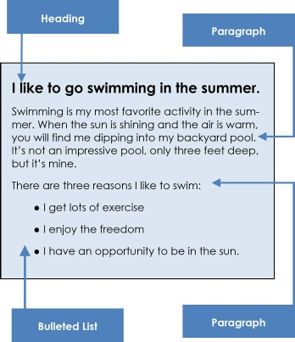
Notes:
HTML stands for HyperText Markup Language. Developed by scientist Tim Berners-Lee in 1990, HTML is the "hidden" code that helps us communicate with others on the World Wide Web (WWW).
When writing HTML, you add "tags" to the text in order to create the structure. These tags tell the browser how to display the text or graphics in the document.
The good news is that HTML is written in plain text. That means you don’t need any fancy software programs to write your code.

Slide 3
Some rules
Tags/Elements -> using < … >
Container and empty tags
<html> opening tag
</html> closing tag
<br> empty tag
HTML is not case sensitive
Notes:
you can use either lowercase or uppercase -> for consistency use one or another always

Slide 4
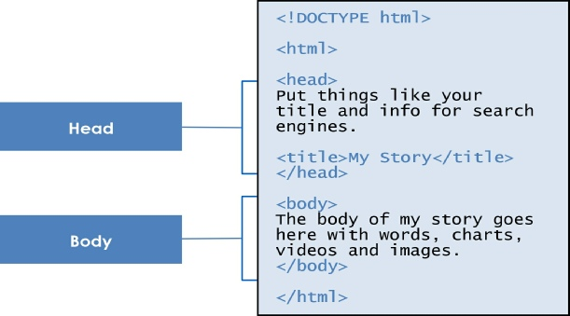
Notes:
<!DOCTYPE html>. It’s telling or declaring to the browser that the following file is an HTML file.
four primary tags: <html>, <head>, <title> and <body> Every HTML document begins and ends with the <html> tag
The <head> tag contains the title of the document along with general information about the file, like the author, copyright, keywords and/or a description of what appears on the page.
Appears within the <head> tags and gives the title of the page. Try to make your titles descriptive, but not more than 20 words in length. The title appears at the very top of the browser page on the title tab.
The main content of your page is placed within the body tags: your text, images, links, tables and so on.
Nesting
Part of the web page structure is called nesting. Notice above how the tag <title> is nested inside the <head> tag, while <head> and <body> are nested inside <html>.

